Slide 1
When Should Humans Overrule AI?

Slide 2
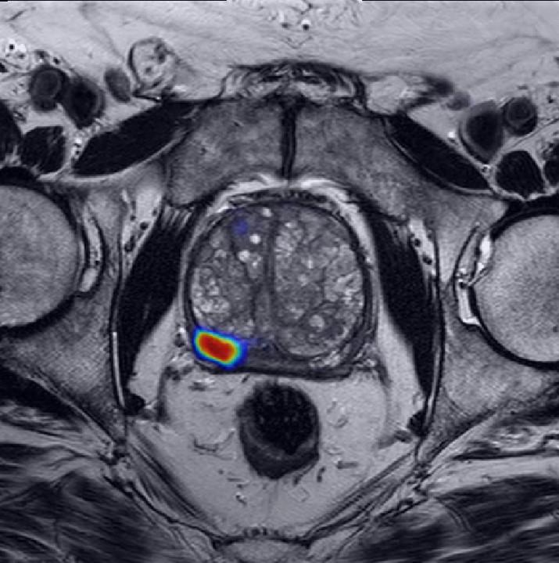
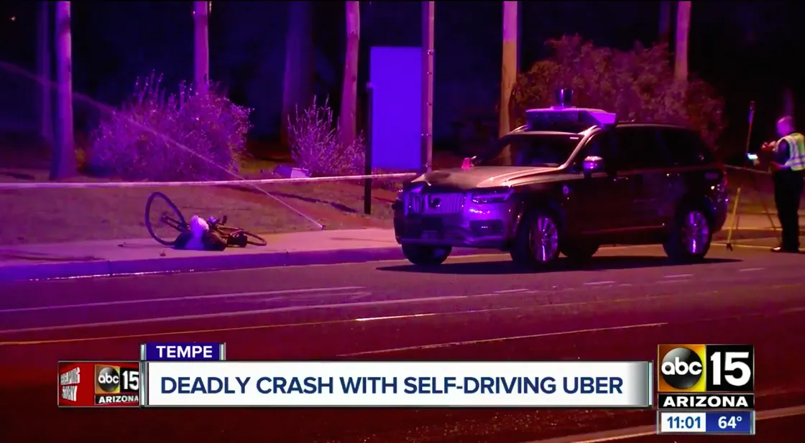
Human-AI Interaction
AI is introduced into many facets of society to help aid in complex problems/tasks.
For example in aircraft this has been used to help guide and land vehicles during conditions where visibility is poor.
AI has been used to help doctors identify cancer in patients
However what happens when the AI gets it wrong?

Slide 3
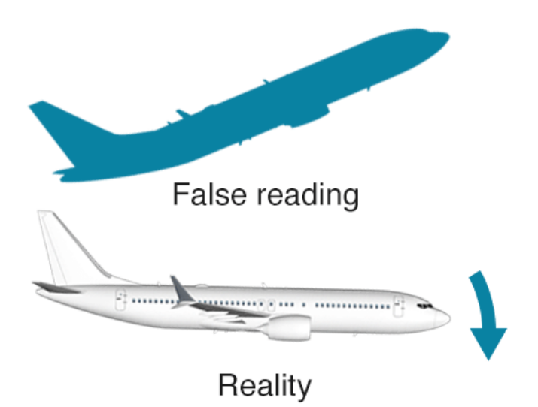
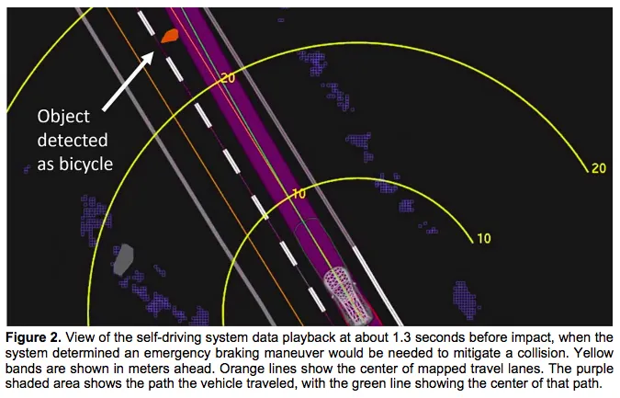
System Issues
Fatalities have occurred due to ineffective AI implementation, lack of warnings and training of personnel.
Boeing 737-MAX crash
Occurred due to erroneous measurements of the Angle of Attack sensors- reliance on only 1 of the two sensors.
Pilots unaware of control modifications made to the 737-MAX and system did not have warnings.
Uber Car Fatality:
Sensors detected an object but did not identify as a cyclist until 1.3s before impact - the emergency braking and manoevershad been disabled beforehand.
Driver was not paying attention - “Automation Complacency”

Slide 4
Solutions
Solutions for when Humans should overrule AI is dependant on the situation/severity of failure. However humans should be able to intervene where system failure occurs.
For example for the previous cases fail-safe instrumentation should be available, clear warnings should be given to drivers with relevant training for the vehicle/control system.
Industries should use current legislation but enhance this for automation- for example with EASA autopilot systems must “perform their intended functions under any foreseeable operating condition” so that:
i) “any catastrophic failure condition is extremely improbable and does not result from a single failure”
ii) “any hazardous failure condition is extremely remote” and “any major failure condition is remote”.
“quick disengagement controls for the autopilot and autothrust functions must be provided for each pilot”, “the autopilot must not create an unsafe condition when the flight crew applies an override force to the flight controls” and “under any condition of flight” the autopilot must not “produce unacceptable loads on the aeroplane” or “create hazardous deviations in the flight path”

